Slide 1
YOUTUBE SONGS ANALYSIS
Dive into an in-depth Power BI analysis of the top YouTube songs from 2022.
This project examines trends, viewer demographics, engagement metrics,
and more, offering valuable insights into the year's most popular music.
BY – SANDESH KUMAR JADHAV

Slide 2
Dataset Description:
1. video_id: Unique identifier for each YouTube video.
2. channelTitle: Title of the YouTube channel publishing the song.
3. title: Title of the YouTube song video.
4. description: Description provided for the YouTube song video.
5. tags: Tags associated with the YouTube song video.
6. publishedAt: Date and time when the YouTube song video was published.
7. viewCount: Number of views received by the YouTube song video.
8. likeCount: Number of likes received by the YouTube song video.
9. favoriteCount: Number of times the YouTube song video has been marked as a favorite.
10. commentCount: Number of comments posted on the YouTube song video.
11. duration: Duration of the YouTube song video.
12. definition: Video definition or quality (e.g., HD, SD).

Slide 3
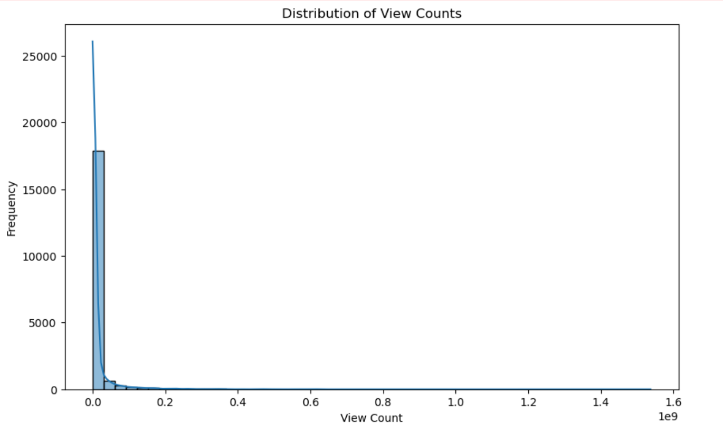
Exploratory Data Analysis
This histogram visualizes the distribution of view counts for the YouTube song videos. The x-axis represents the number of views, while the y-axis shows the frequency of videos within each view count range. The KDE curve provides a smooth approximation of the data distribution, highlighting trends and outliers in viewership.

Slide 4
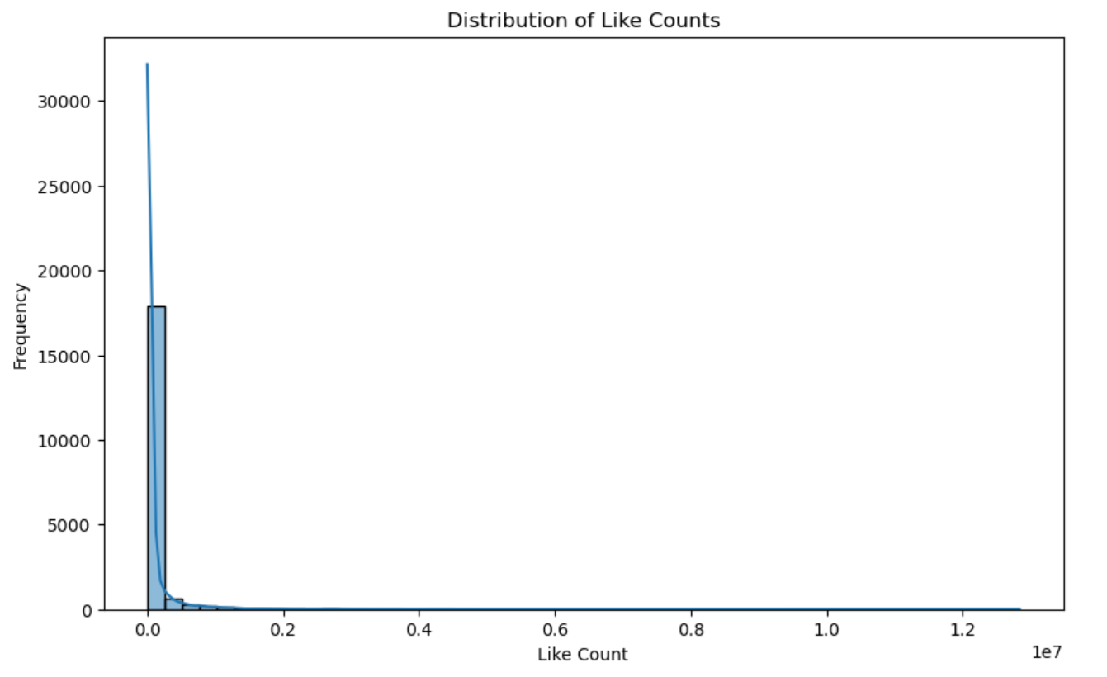
Exploratory Data Analysis
This histogram illustrates the distribution of like counts for the YouTube song videos. The x-axis shows the number of likes, and the y-axis indicates the frequency of videos within each like count range. The KDE curve helps visualize the overall trend and density of likes across the dataset.

Slide 5
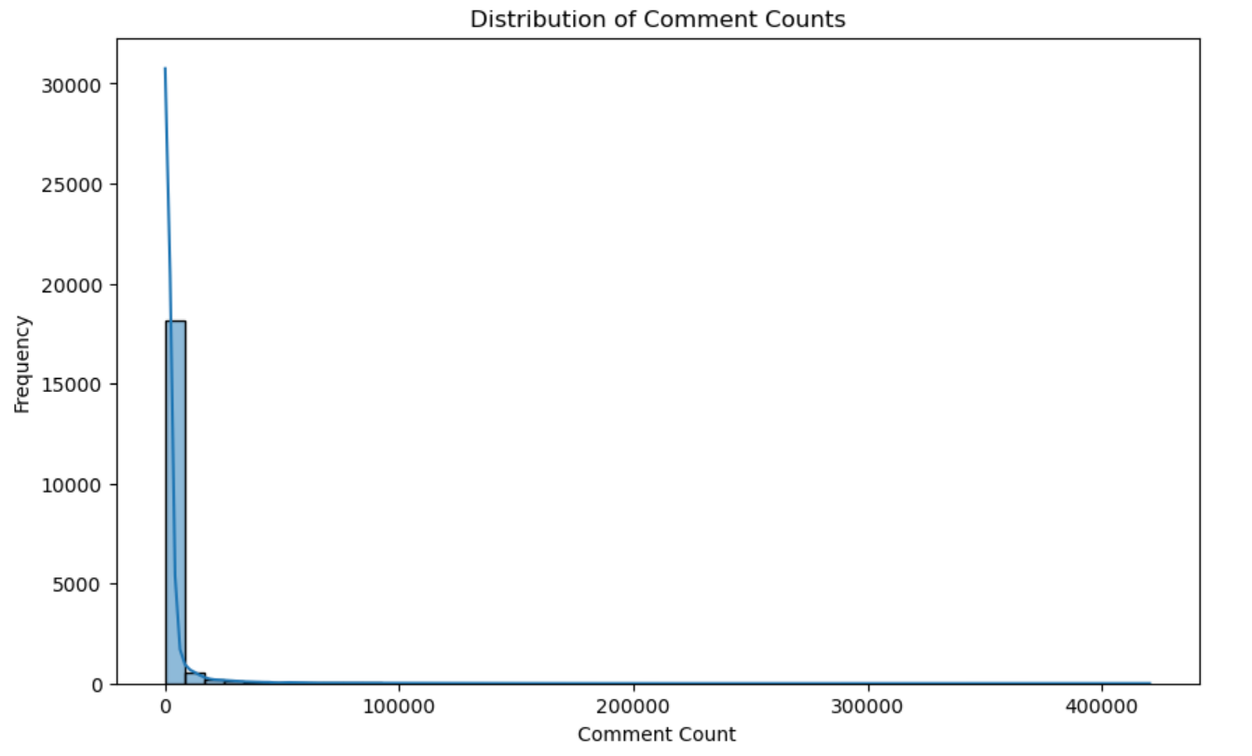
Exploratory Data Analysis
This histogram displays the distribution of comment counts for the YouTube song videos. The x-axis represents the number of comments, while the y-axis shows the frequency of videos within each comment count range. The KDE curve provides a smooth representation of the data's density and distribution.

Slide 6
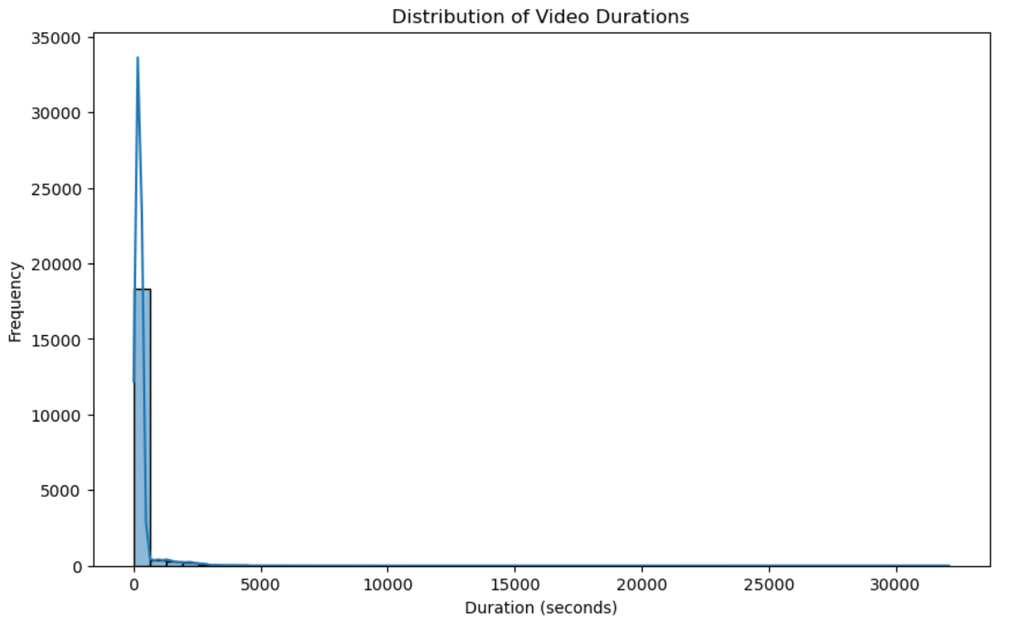
Exploratory Data Analysis
This histogram displays the distribution of video durations for the YouTube song videos. The x-axis represents the duration in seconds, while the y-axis shows the frequency of videos within each duration range. The KDE curve provides a smooth approximation of the data distribution, highlighting trends in video lengths.

Slide 7
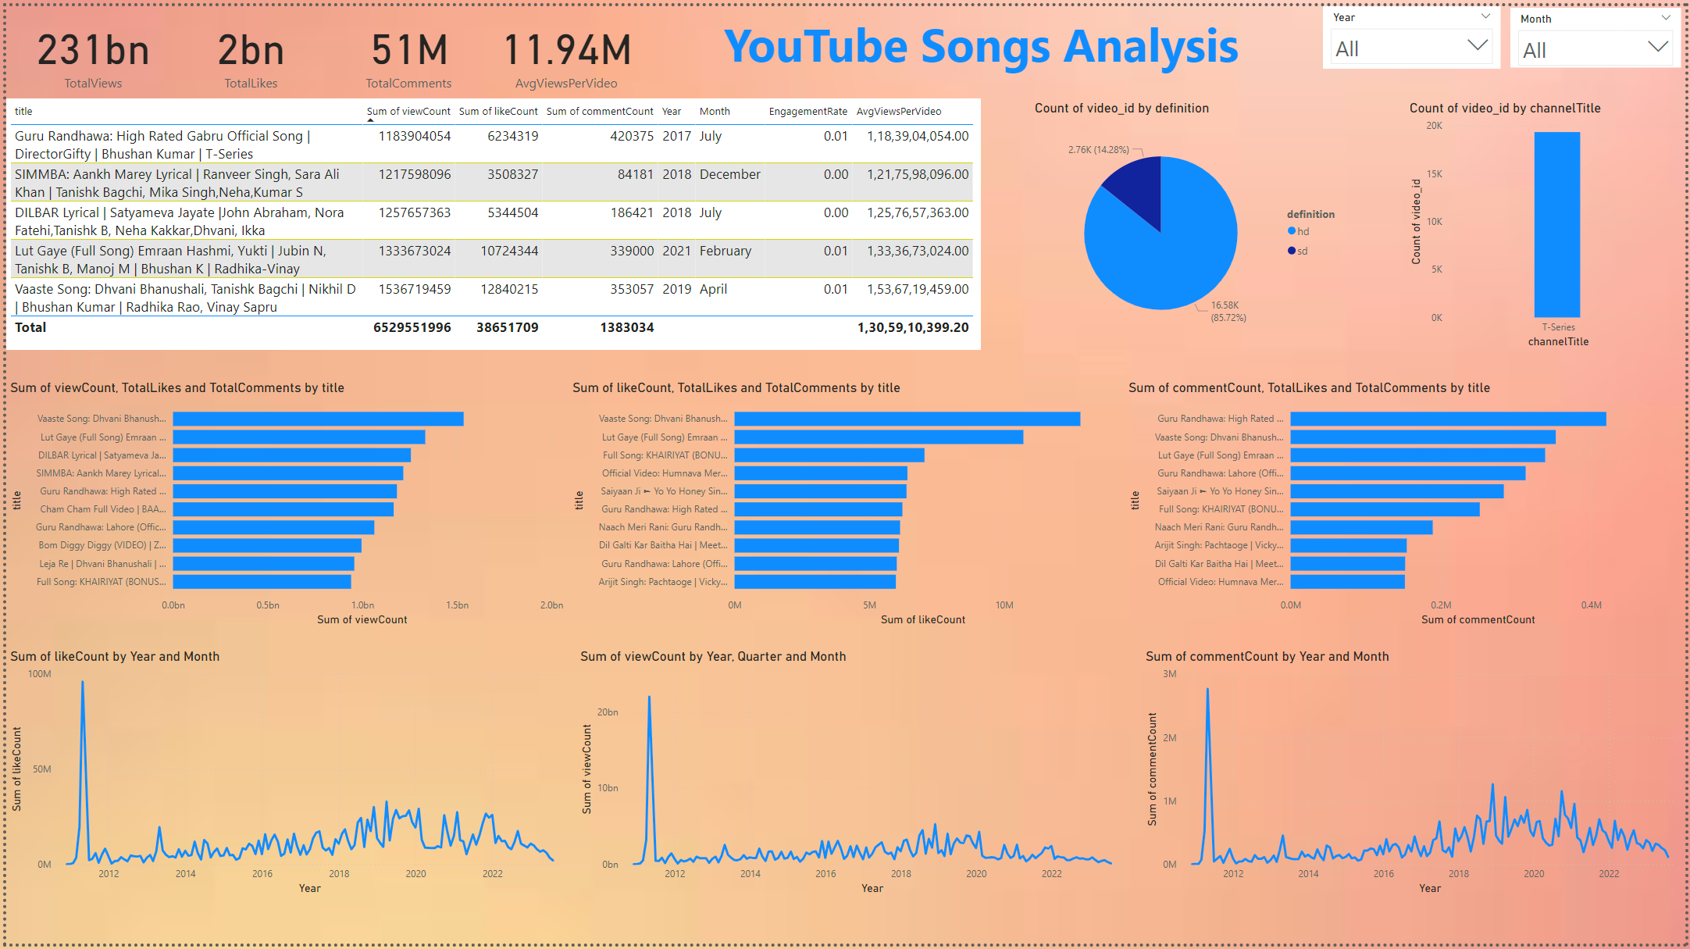
Power BI Dashboard Analysis

Slide 8
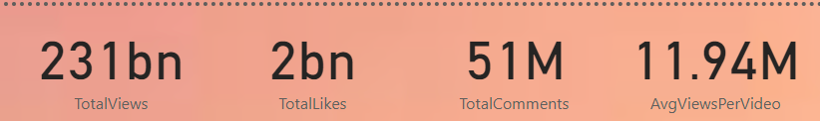
Key Metrics Overview
Total Views: 231 billion
Total Likes: 2 billion
Total Comments: 51 million
Average Views Per Video: 11.94 million

Slide 9
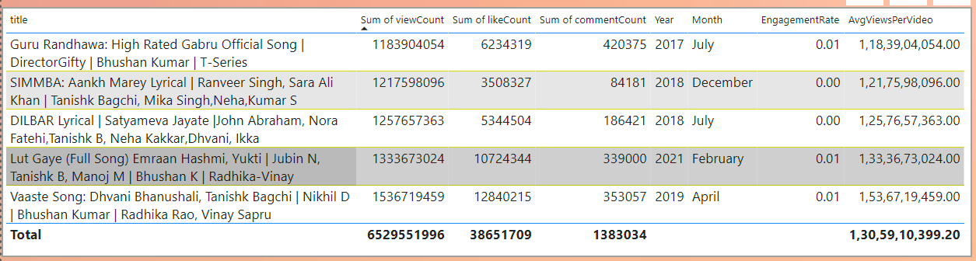
Top Songs and Engagement Metrics
Some songs stand out for their extraordinary engagement:
"High Rated Gabru" by Guru Randhawa: Over 1.18 billion views, 62 million likes, and 420 thousand comments.
"Aankh Marey" by Ranveer Singh: 1.21 billion views, 35 million likes, 84 thousand comments.
"DILBAR" by Nora Fatehi: 1.25 billion views, 53 million likes, 186 thousand comments.
These songs have captivated audiences, driving significant interaction and illustrating the power of catchy tunes and star power.

Slide 10
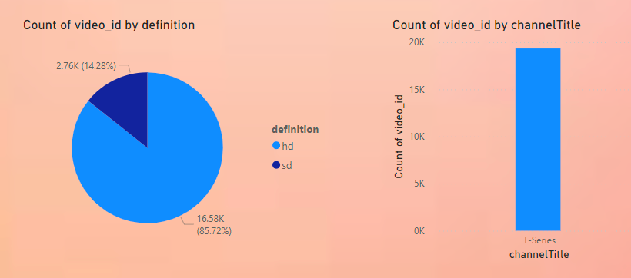
Video Definition and Channel Distribution
Video Quality: The majority (85.72%) of the videos are in HD, reflecting a viewer preference for high-definition content.
Channel Dominance: T-Series leads with the highest number of videos, indicating its strong presence in the music industry.
High-quality videos from prominent channels are more likely to attract and retain viewers, enhancing overall engagement.

Slide 11
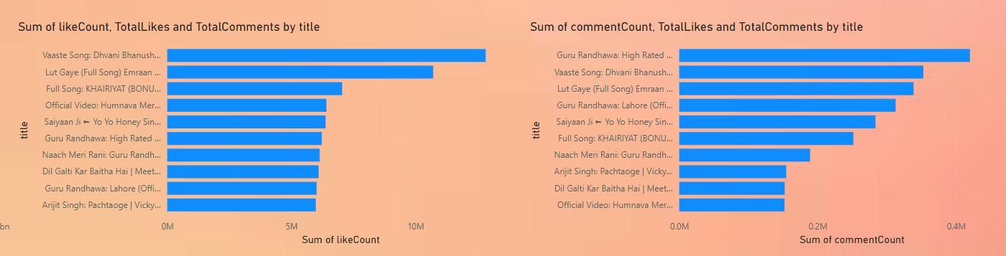
Most Liked and Commented Videos
Most Liked Video: "Vaaste Song" by Dhvani Bhanushali, showing exceptional viewer appreciation.
Most Commented Video: "High Rated Gabru" by Guru Randhawa, indicating high levels of viewer interaction and engagement.
These metrics showcase which songs not only attract views but also elicit strong reactions and discussions among viewers.

Slide 12
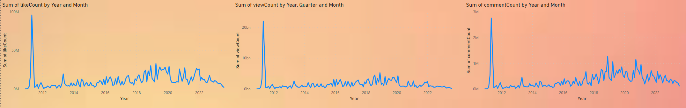
Engagement Trends Over Time
Peak Engagement Periods: Notable spikes in engagement around 2018 and 2019, possibly linked to viral hits or significant releases.
Consistent Engagement: A steady increase in views, likes, and comments over the years, reflecting sustained interest in YouTube music videos.
Understanding these trends helps us identify periods of heightened activity and the factors that drive viewer engagement.

Slide 13
Summary and Conclusions
HD Content Dominates: 85.72% of videos are in HD, meeting viewer expectations for high-quality visuals.
T-Series Dominance: The channel's extensive catalog and consistent high viewership underscore its leading role in the industry.
Engagement Leaders: Songs like "High Rated Gabru" and "Vaaste" exemplify successful content that drives significant interaction.
These insights provide a comprehensive understanding of the dynamics within YouTube's music video landscape, offering valuable lessons for content creators and marketers aiming to enhance viewer engagement.

